Slide 1
Chongqing University of Technology
ATAI
Advanced Technique of Artificial Intelligence
Chongqing University of Technology
Deep Fusion Clustering Network（AAAI_2021）
Wenxuan Tu, Sihang Zhou, Xinwang Liu, Xifeng Guo, Zhiping Cai, En zhu, Jieren Cheng
College of Computer, National University of Defense Technology, Changsha, China
College of Intelligence Science and Technology, National University of Defense Technology, Changsha, China
College of Computer Science and Cyberspace Security, Hainan University, Haikou, China
Hainan Blockchain Technology Engineering Research Center, Haikou, China
{wenxuantu, guoxifeng1990, cjr22}@163.com, sihangjoe@gmail.com, {xinwangliu, zpcai, enzhu}@nudt.edu.cn
2021.4.18 • ChongQing
Reported by Lele Duan
Code&dataset:https://github.com/WxTu/DFCN

Slide 2
Chongqing University of Technology
ATAI
Advanced Technique of Artificial Intelligence
Chongqing University of Technology
1.Introduction
2.Method
3.Experiments

Slide 3
Introduction
Chongqing University of Technology
ATAI
Advanced Technique of Artificial Intelligence
Existing literature :
Combining autoencoder and graph neural networks.
Lacking a dynamic fusion mechanism.
Failing to extract information from both sides for robust target distribution.

Slide 4
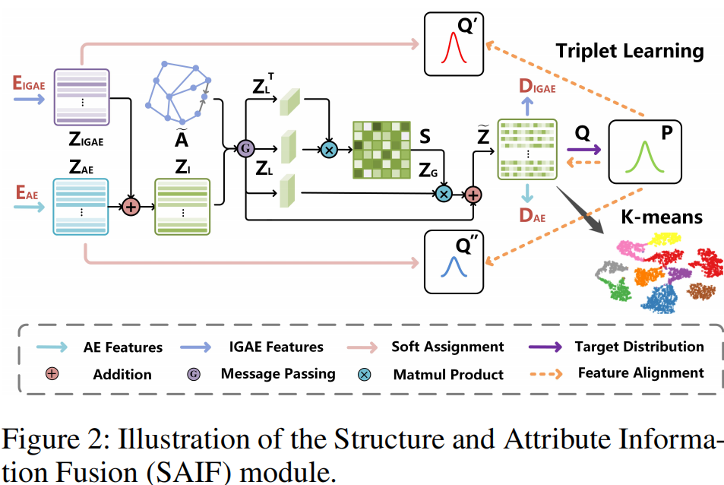
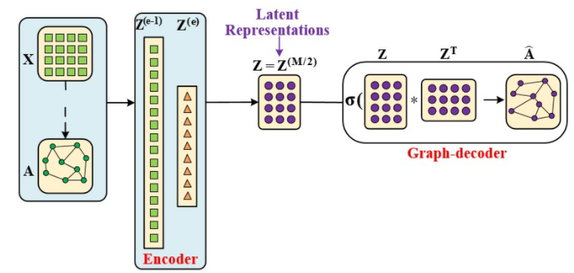
Method
Chongqing University of Technology
ATAI
Advanced Technique of Artificial Intelligence
Improved Graph Autoencoder（IGAE）：
（encoder）
Improved Graph Autoencoder（IGAE）：
（decoder）
GAE
（encoder-only）

Slide 5
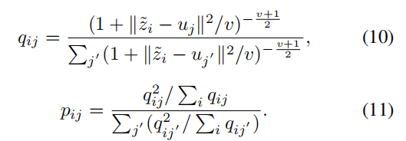
Method
Chongqing University of Technology
ATAI
Advanced Technique of Artificial Intelligence
Cross-modality Dynamic Fusion Mechanism：
Triplet Self-supervised Strategy：
Joint loss and Optimization ：

Slide 6
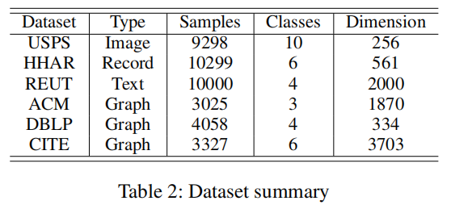
Chongqing University of Technology
ATAI
Advanced Technique of Artificial Intelligence
Experiments

Slide 7
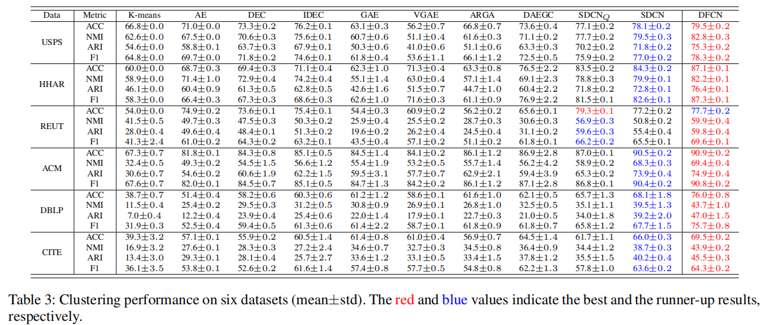
Chongqing University of Technology
ATAI
Advanced Technique of Artificial Intelligence
Experiments

Slide 8
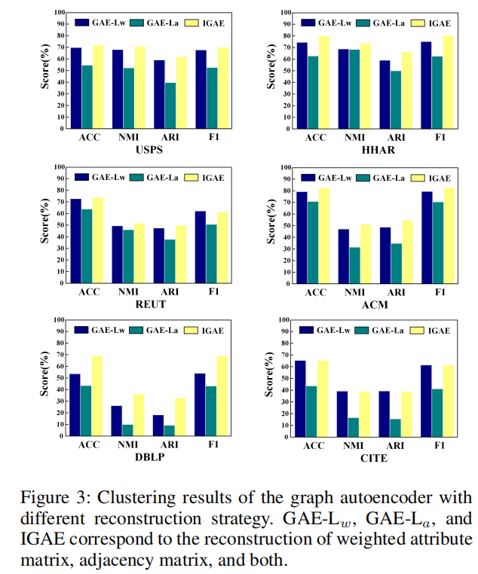
Experiments
ATAI
Chongqing University of Technology
Advanced Technique of Artificial Intelligence

Slide 9
Chongqing University of Technology
ATAI
Experiments
Advanced Technique of Artificial Intelligence

Slide 10
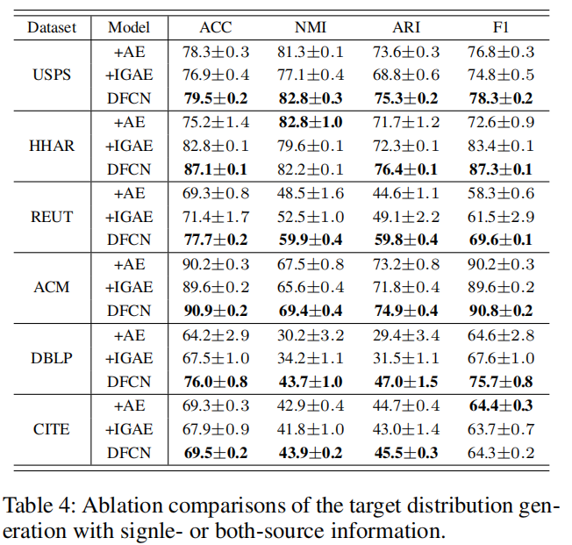
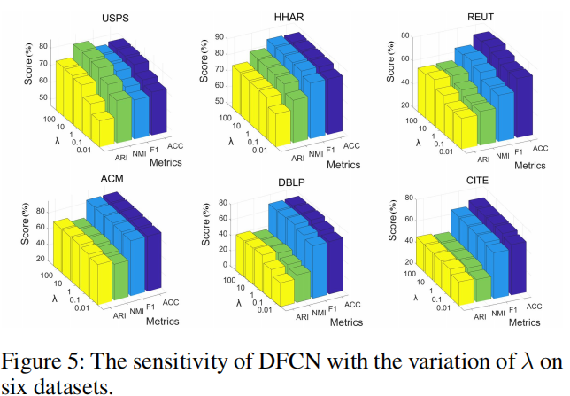
Chongqing University of Technology
ATAI
Experiments
Advanced Technique of Artificial Intelligence

Slide 11
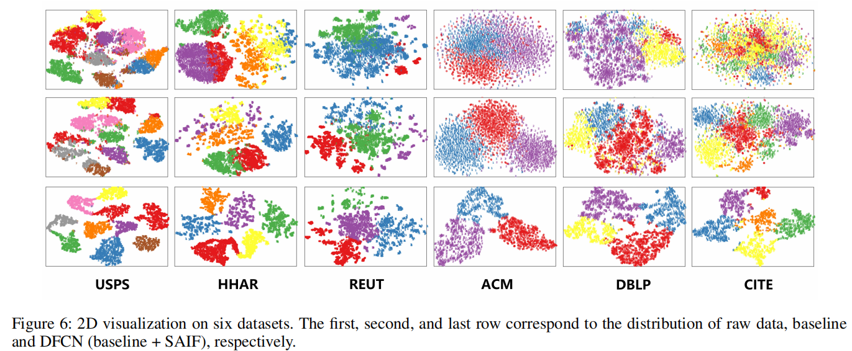
Chongqing University of Technology
ATAI
Advanced Technique of Artificial Intelligence
Experiments

Slide 12
Chongqing University of Technology
ATAI
Advanced Technique of Artificial Intelligence
Chongqing University of Technology
Thank you!

